Slide 1

Aiman Zahoor F2020-550
Zainab Usama F2020-372

Slide 2
Problem
Many people face financial hardships, making new purchases difficult.
Unused and rarely used items contribute significantly to waste.
Additionally, quality concerns in thrift stores and the lack of web-based thrift platforms in Pakistan complicate the process for users.

Slide 3
About Us
Based in Pakistan, Thriftn’ promotes item reuse to help consumers save money and the environment. We provide a web app that makes it simple to buy and sell pre-loved items, declutter and donate to worthwhile organizations. Every transaction brings about improvement. One item at a time, we can change things together. It’s a is a movement rather than just a store.

Slide 4
Core Features
Quality Control: An image quality detector helps buyers assess items.
Trusted Sellers: Badges based on reviews and ratings to help buyers shop confidently.
Price Negotiation: Directly negotiate prices with sellers.
Personalized Shopping: A recommendation system and filters tailor suggestions to your interests.

Slide 5
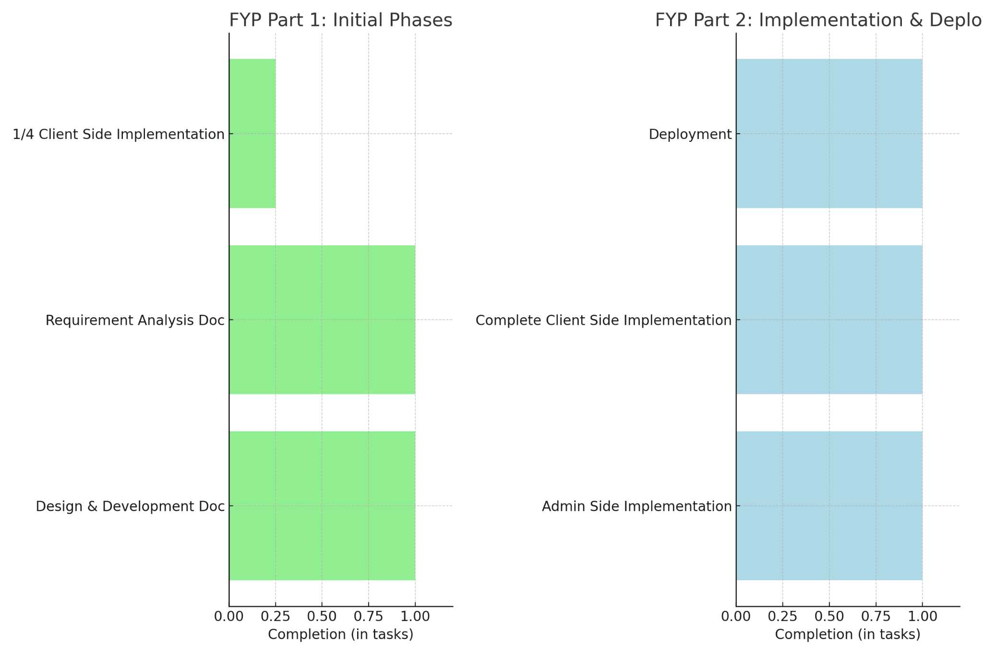
Fig. Work done in FYP1 & FYP2

Slide 6
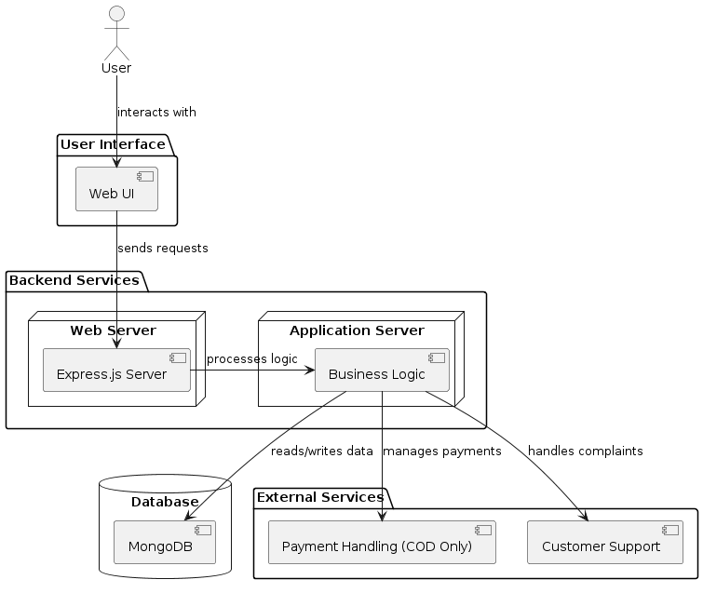
Fig. Architecture diagram

Slide 7
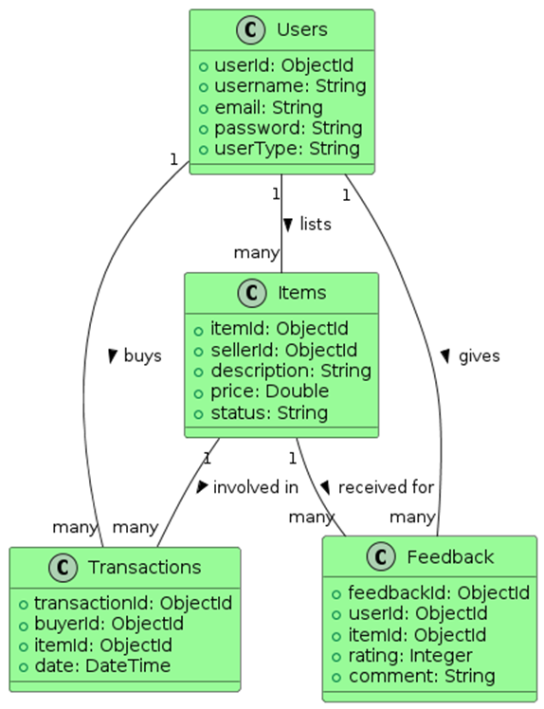
Fig. Data Design diagram

Slide 8
Challenges
Encountered ongoing deployment challenges from the beginning of Part 1.
Numerous technical issues during the first attempt for deployment on DigitalOcean.
Switched to Ngrok but faced issues.
Eventually moved to Heroku, where the project was successfully deployed after several tries.

Slide 9
Future Work
AI Image Content Detection:
Analyze images uploaded by sellers to automatically categorize items and detect key features, streamlining the process.
AI Moderation for Policy Compliance:
Restrict or ban profiles that violate guidelines.

Slide 10
Project Demo

